Slide 1
Shangquan Sun, Runyu Zheng
Kim Hazelwood, Sarah Bird, David Brooks, Soumith Chintala, Utku Diril, Dmytro Dzhulgakov, Mohamed Fawzy, Bill Jia, Yangqing Jia, Aditya Kalro, James Law, Kevin Lee, Jason Lu, Pieter Noordhuis, Misha Smelyanskiy, Liang Xiong, Xiaodong Wang
Carole-Jean Wu, David Brooks, Kevin Chen, Douglas Chen, Sy Choudhury, Marat Dukhan, Kim Hazelwood, Eldad Isaac, Yangqing Jia, Bill Jia, Tommer Leyvand, Hao Lu, Yang Lu, Lin Qiao, Brandon Reagen, Joe Spisak, Fei Sun, Andrew Tulloch, Peter Vajda, Xiaodong Wang, Yanghan Wang, Bram Wasti, Yiming Wu, Ran Xian, Sungjoo Yoo, Peizhao Zhang
Applied Machine Learning at Facebook: A Datacenter Infrastructure Perspective
Machine Learning at Facebook: Understanding Inference at the Edge

Slide 2
Applied Machine Learning at Facebook: A Datacenter Infrastructure Perspective

Slide 3
Topics
Overview of Facebook’s Machine Learning (ML) workloads
ML approaches at Facebook
Resource Implications of ML
Datacenter at Facebook
Future Directions in Co-design: Hardware, Software, and Algorithms

Slide 4
Facebook’s Major Services Leveraging ML
News Feed
Ads
Search
Sigma
Lumos
Facer
Language Translation
Speech Recognition

Slide 5
Facebook’s corresponding ML Models
Logistic Regression (LR) & Support Vector Machines (SVM)
Gradient Boosted Decision Trees (GBDT)
Deep Neural Networks (DNN)
Multi-Layer Perceptrons (MLP)
Convolutional Neural Networks (CNN)
Recurrent Neural Networks (RNN/LSTM)

Slide 6
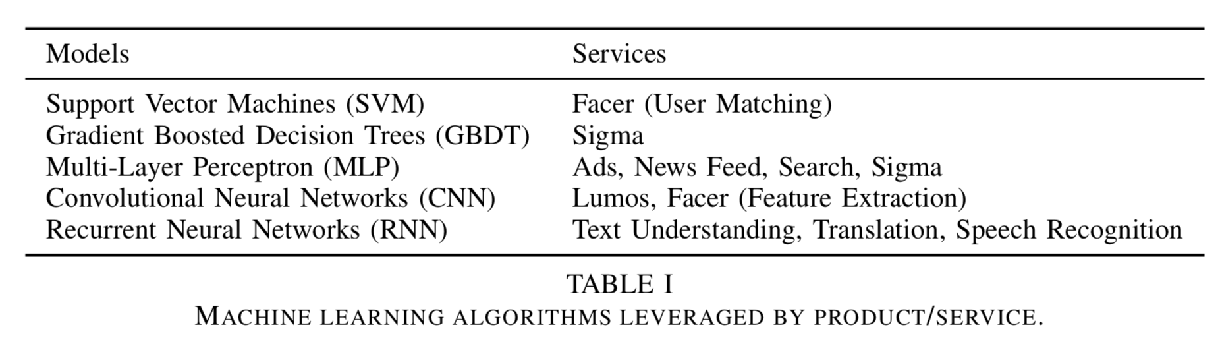
ML models leveraged by Facebook’s services

Slide 7
Platforms and Toolkits Inside Facebook
FBLearner
FBLearner Feature Store
FBLearner Flow
FBLearner Predictor
Caffe2
PyTorch
ONNX

Slide 8
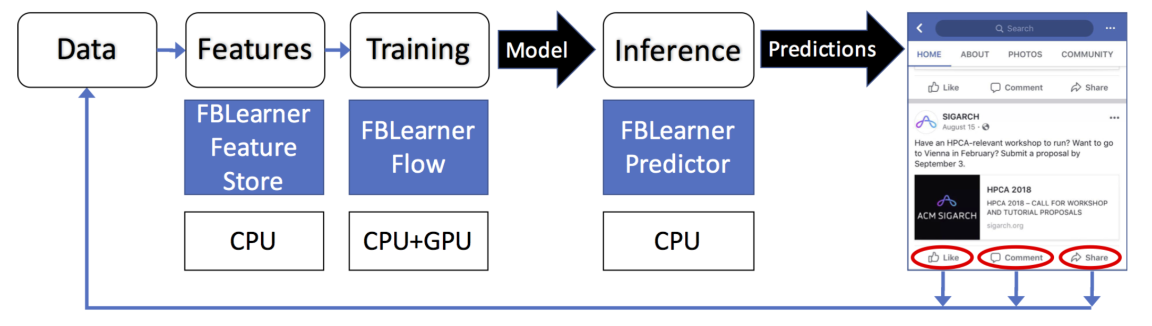
FBLearner
Machine Learning Flow and Infrastructure

Slide 9
FBLearner
Machine Learning Flow and Infrastructure

Slide 10
FBLearner
Machine Learning Flow and Infrastructure

Slide 11
Deep Learning Frameworks
Caffe2
Facebook’s production framework
PyTorch
Framework of choice for AI research at Facebook
Dependence on Python
ONNX (Open Neural Network Exchange)
A format to represent deep learning models in a standard way to enable interoperability across different frameworks and vendor-optimized libraries.
Way to exchange trained models between different frameworks or platforms

Slide 12
Resource Implication of ML
Facebook’s Hardware Resources
Resource Implications of Offline Training
Resource Implications of Online Inference

Slide 13
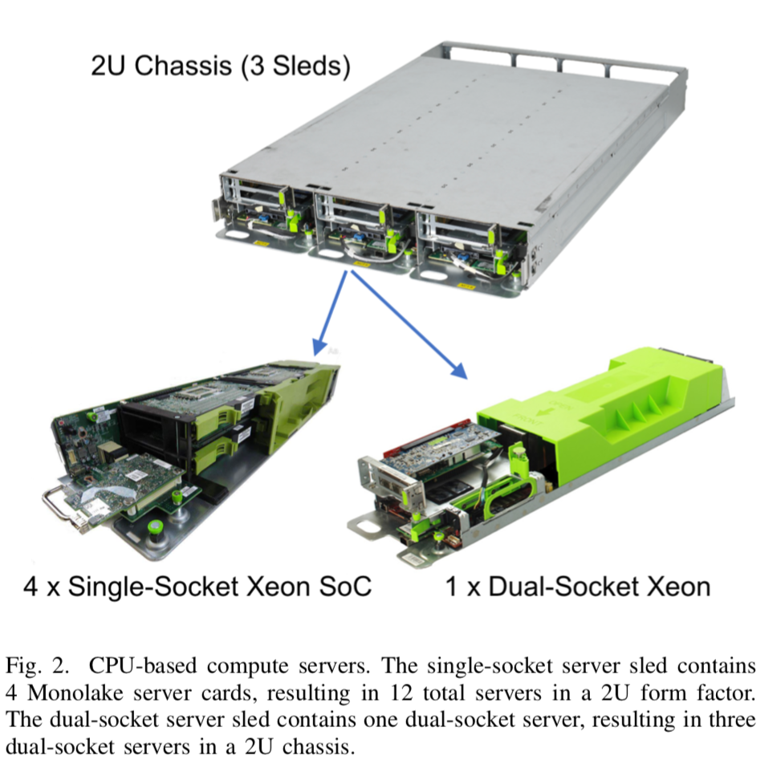
Facebook’s Hardware Resources
8 major compute and storage rack types for 8 major services
e.g. 2U chassis with 3 compute sleds
Big Basin
latest-generation GPU server from 2017
8 NVIDIA Tesla P100/V100 GPU
Big Sur
earlier GPU server
NVIDIA M40 GPUs

Slide 14
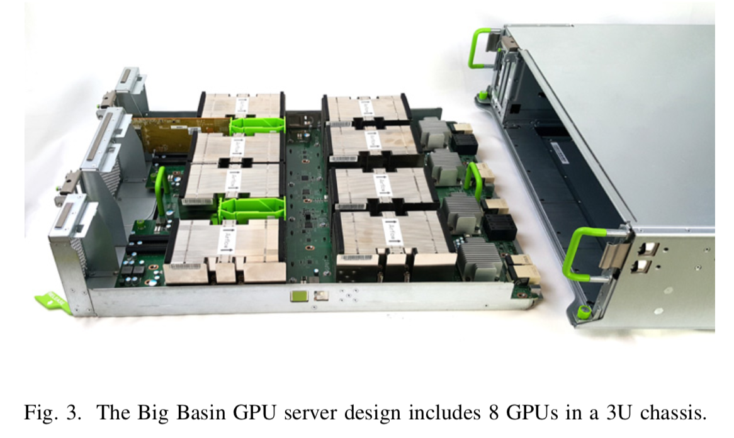
Facebook’s Hardware Resources
8 major compute and storage rack types for 8 major services
e.g. 2U chassis with 3 compute sleds
Big Basin
latest-generation GPU server
8 NVIDIA Tesla P100/V100 GPU
Big Sur
earlier GPU server
NVIDIA M40 GPUs

Slide 15
Resource Implications of Offline Training
GPUs: Lumos, Speech Recognition, Language Translation
CPUs: News Feed, Sigma
Both: Facer , Search

Slide 16
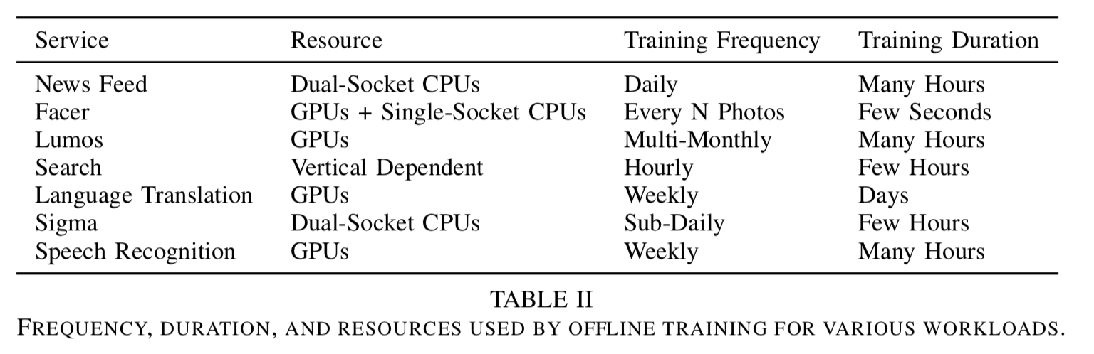
Resource Implications of Offline Training

Slide 17
Resource Implications of Offline Training
Memory, Storage, and Network
Locality of data
Scaling Considerations
Data parallelism by Ethernet- based networking
Distributed training

Slide 18
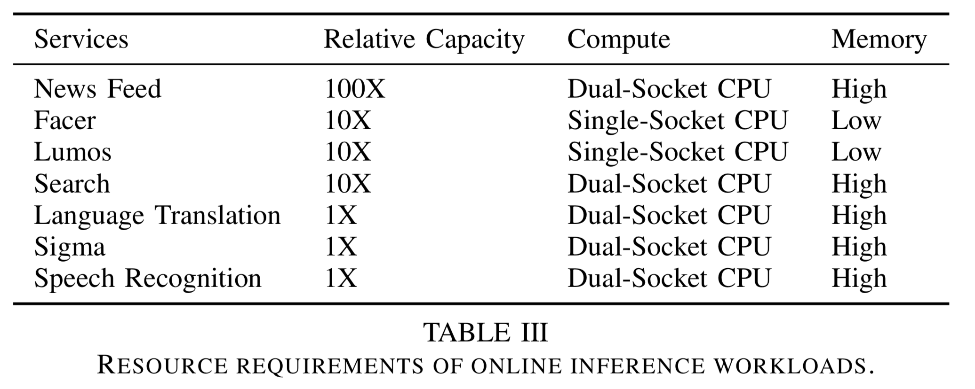
Resource Implications of Online Inference

Slide 19
ML at Datacenter Scale SCALE
Getting Data to the Models
Leveraging Scale
Disaster Recovery

Slide 20
Getting Data to the Models
Decouple the data workload from the training workload
“readers”: read the data from storage, process and condense them,
“trainers”: receive data from “readers”

Slide 21
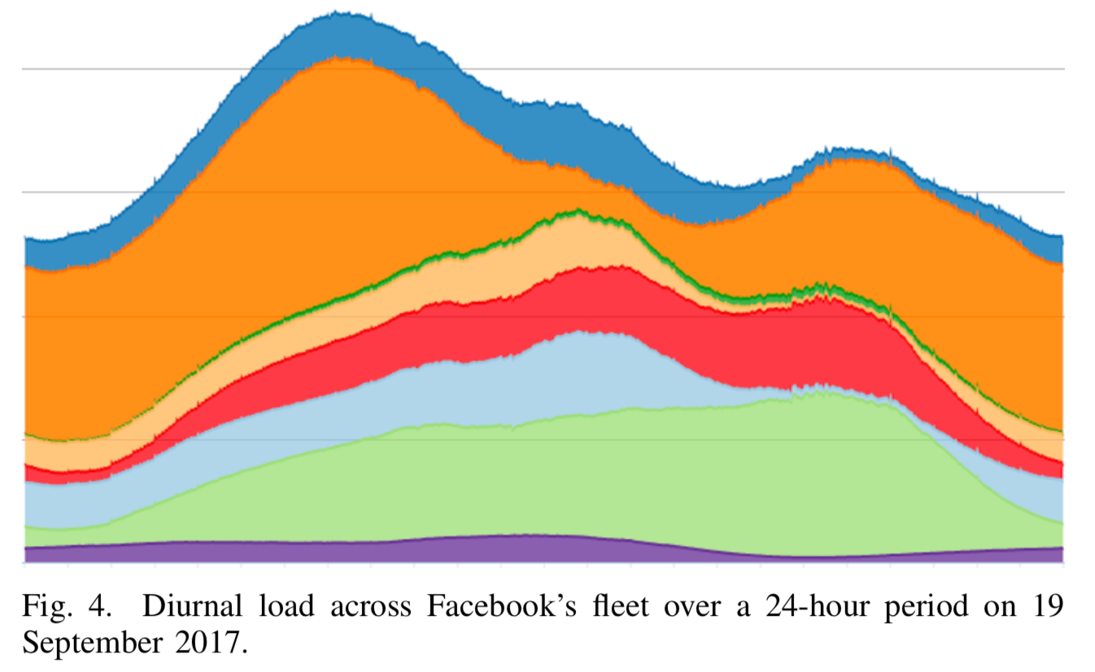
Leveraging Scale
Many idle compute resources
Heterogeneous hardware
co-design between network topology and scheduler

Slide 22
Disaster Recovery
Identify and fix the weakest links in infrastructure
Do frequent model training
e.g. Community Integrity, News Feed, Ads

Slide 23
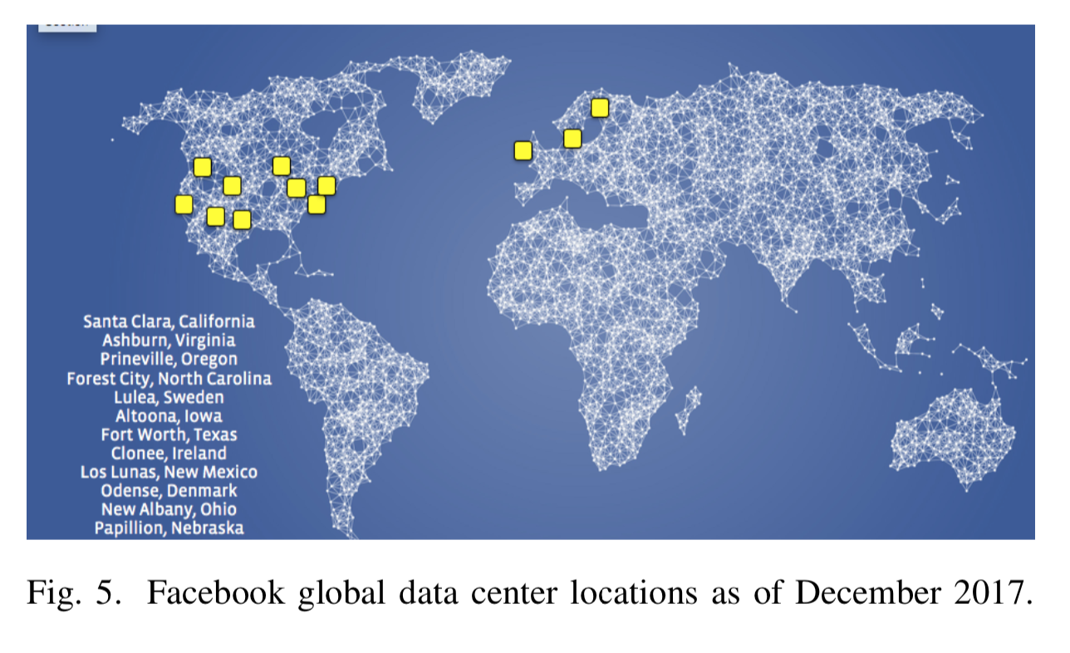
Infrastructure Support for Disaster Recovery
Ample compute servers
Physical locations of the GPUs to be diversified

Slide 24
Future work
Do model compression
quantization
sparsification
Reduce training time and expedite model delivery by distributed training
hierarchical synchronization system (for synchronous SGD)
shared parameter server (for asynchronous SGD)

Slide 25
Discussion
How to improve Disaster Recovery for those less frequently trained services, e.g. Facer (once every few years)?
Why are some models trained on CPUs, since GPUs are usually faster, e.g. News Feed, Sigma?
Why does Facebook only use CPU for inference, since they have tons of inference request every day?
Does FBLearner Flow have the same idea as TensorFlow?
When using ONNX for modeling transferring, does ONNX optimize the model after transferring or people have to optimize on their own after they get the transferred model?

Slide 26
Machine Learning at Facebook: Understanding Inference at the Edge

Slide 27
Inference at the Edge
Benefit
Reduced latency
Less dependency on network
Widely used
Augmented and virtual reality
Speech recognition
Translations

Slide 28
Inference at the Edge
Benefit
Reduced latency
Less dependency on network
Widely used
Augmented and virtual reality
Speech recognition
Translations
Provide insights with data and industry experience

Slide 29
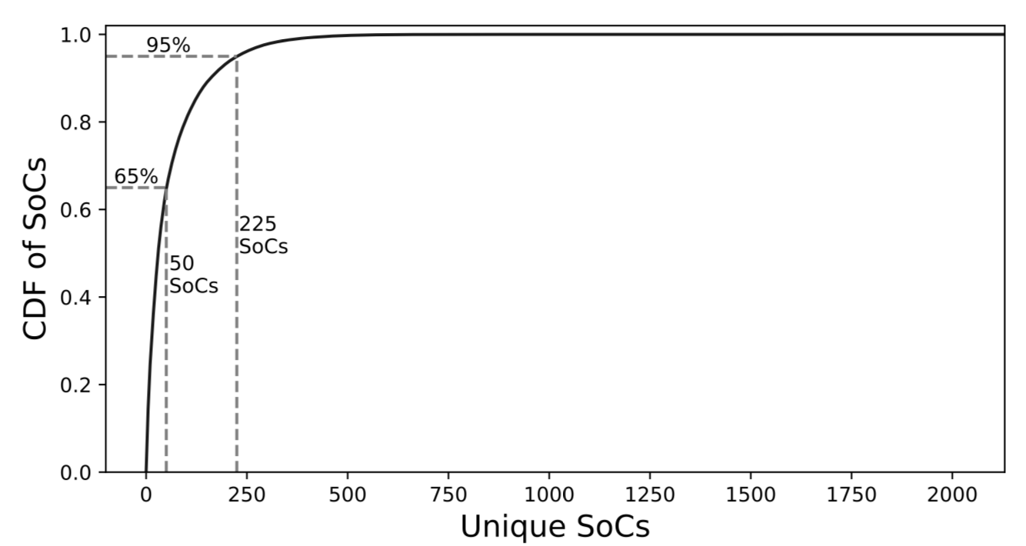
Survey of Mobile Devices: Mobile Chipset
No standard mobile chipsets to optimize for
The top 50 SoCs(System on a Chip) => only 65% of the market

Slide 30
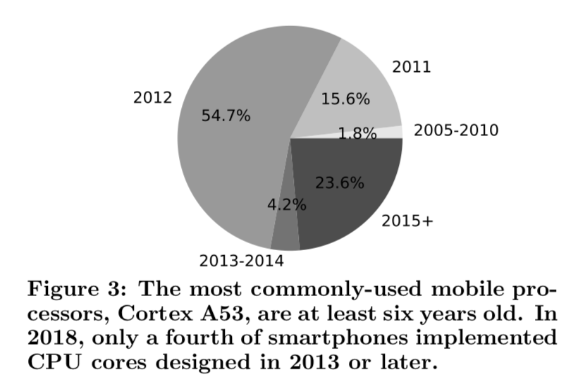
Survey of Mobile Devices: Mobile CPUs
Mobile CPUs show little diversity
72% mobile CPUs => more than 6 years old (2018)
Two dominant architectures
Half of the SoCs have two clusters
high performance / energy efficiency
Target high-performance cluster

Slide 31
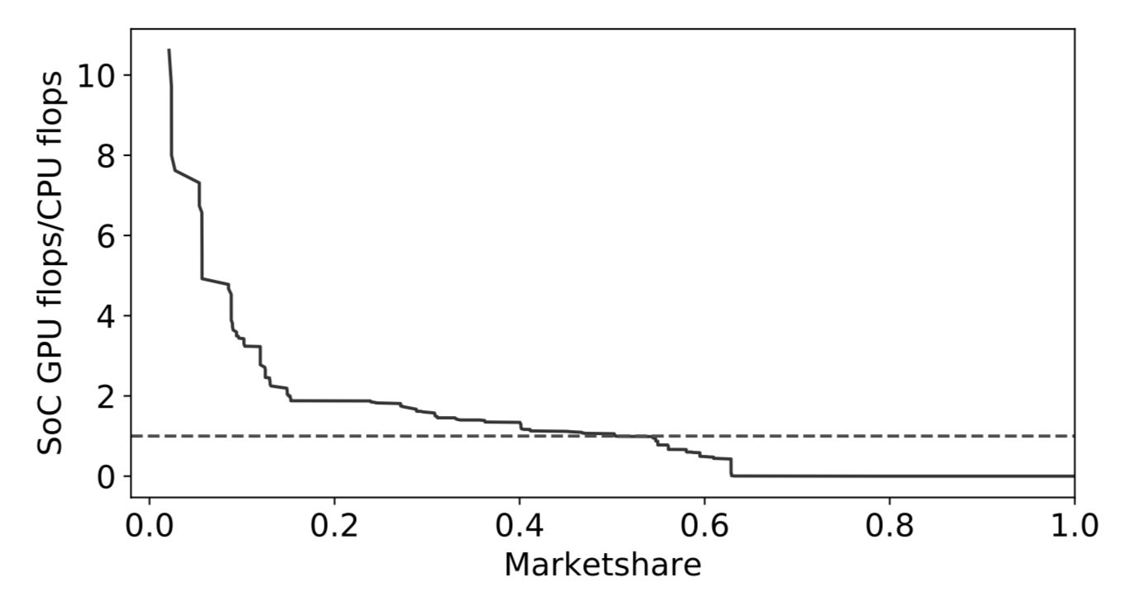
Survey of Mobile Devices: GPU vs CPU
Median Android device => GPU performance ≈ CPU performance
GPU performance limited by memory bandwidth
As a result, the majority of inference run on CPUs

Slide 32
Survey of Mobile Devices: Co-processors
DSPs(domain-specific co-processor)
Higher performance with lower power consumption
Not prevalent (5% of Qualcomm-based SoCs)
NPUs(neural processing unit)
Specific designed for DNN
Not prevalent
Fewer programmable by third parties

Slide 33
Survey of Mobile Devices: Programmability of Co-processors
OpenCL
No conformance tests
Not stable => 1% of the devices crash when loading OpenCL
OpenGL ES and Vulkan
Not supported by all devices
83% => OpenGL ES 3.0 (or newer)
52% => OpenGL ES 3.1 (or newer)
36% => Vulkan
More research and engineering efforts

Slide 34
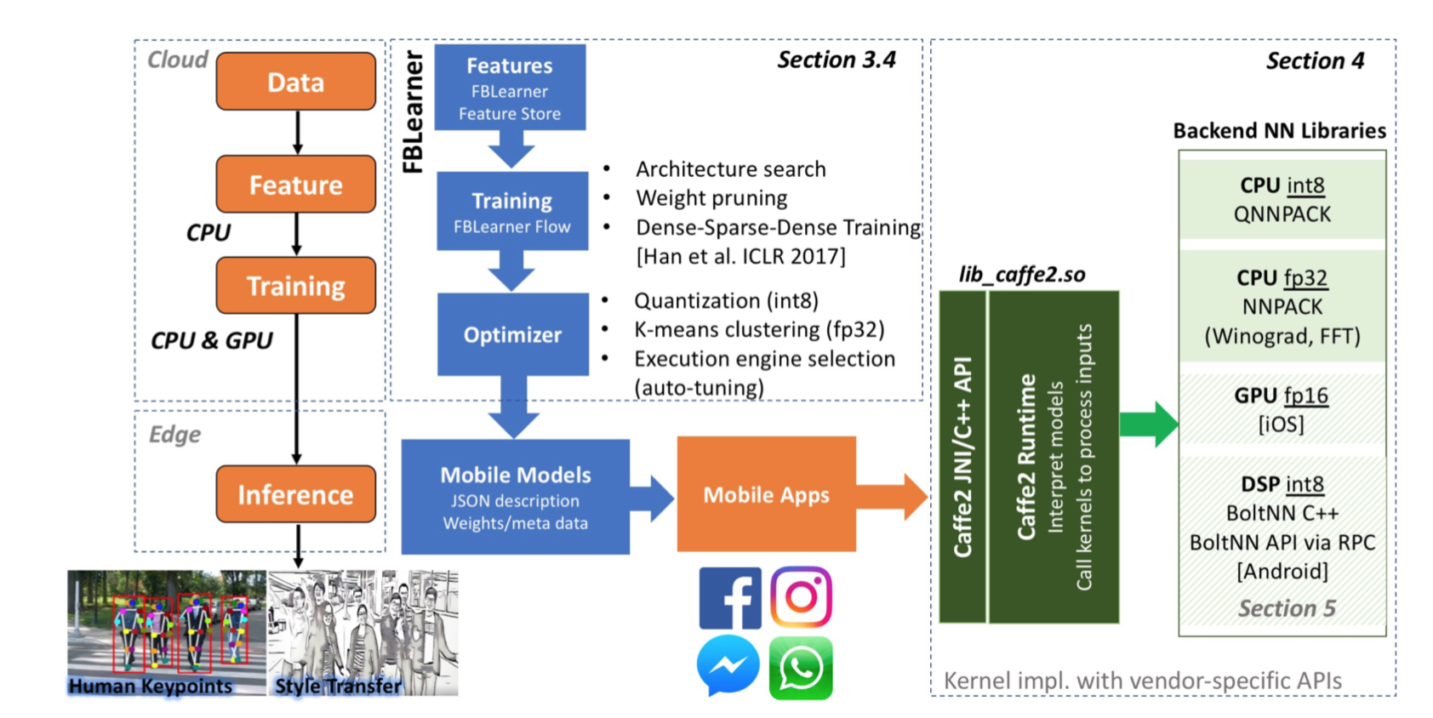
Machine Learning at Facebook

Slide 35
Machine Learning at Facebook

Slide 36
Machine Learning at Facebook

Slide 37
Machine Learning at Facebook

Slide 38
Machine Learning at Facebook

Slide 39
Inference on Smartphones: Backends
Caffe2 Integrates two mobile CPU backends:
NNPACK (Neural Networks PACKage)
Fast convolution algorithm for multicore CPUs
Target high-intensity CNN
QNNPACK (Quantized NNPACK)
Quantized model => Reduced memory footprint
Target low-intensity CNN
Higher computation efficiency
Reduced memory bandwidth
x Optimized with algorithm

Slide 40
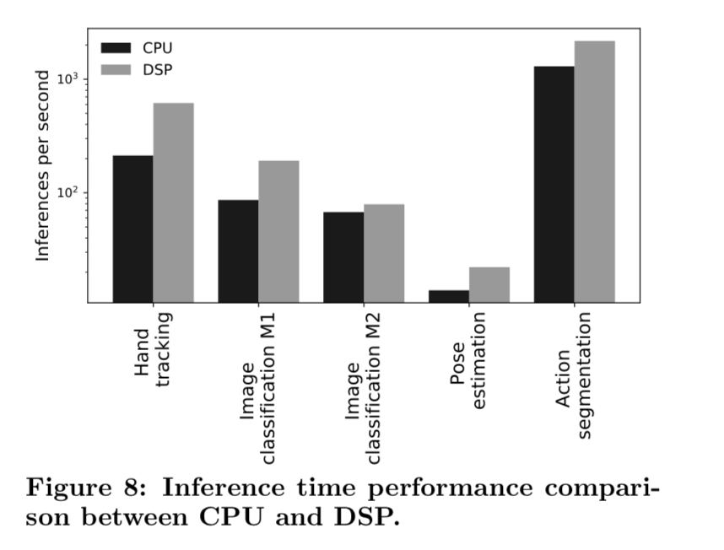
Inference on VR Platform: CPU vs DSP
Simple convolution operators => speedup higher
Intensive memory-bound operations => speedup lower
Extra computations to optimize memory layout

Slide 41
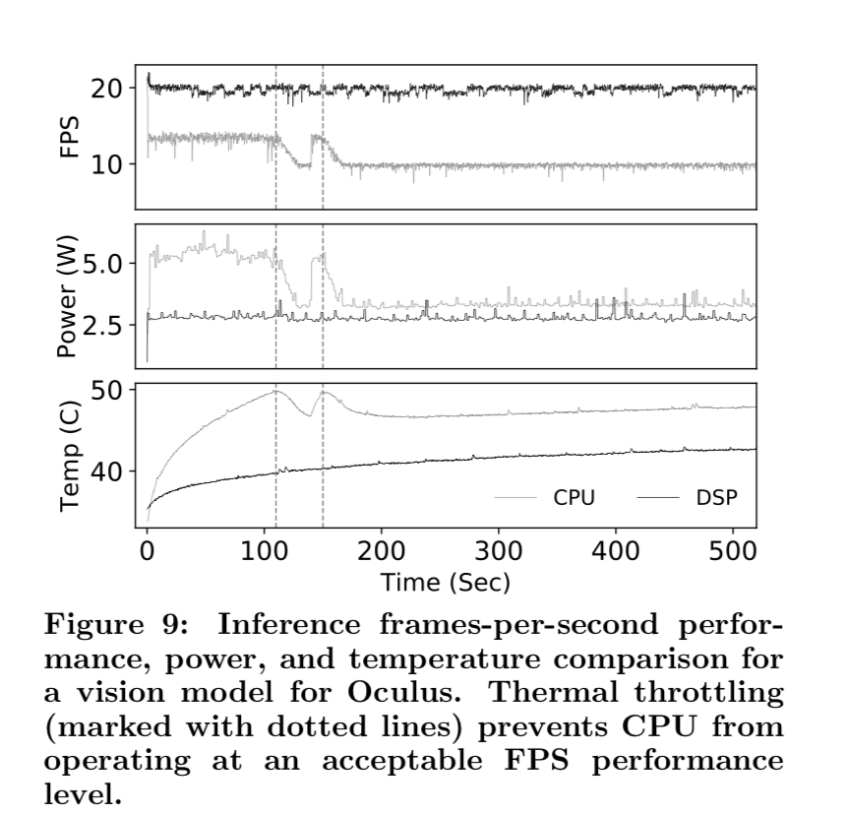
Inference on VR Platform: CPU vs DSP
Energy efficiency
Beginning: CPU 2x
After power throttling: CPU 1.18x

Slide 42
Inference on VR Platform: CPU vs DSP
Programming overhead
DSP significantly higher programming overhead
Quantization
Optimization for memory layout

Slide 43
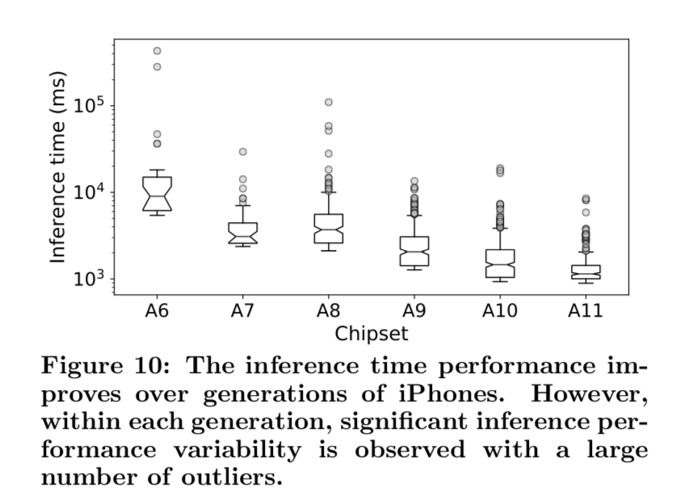
Inference in the Wild: Performance variability
Inference performance varies even across the same device
Background activities
Smartphone surface temperature
Battery aging

Slide 44
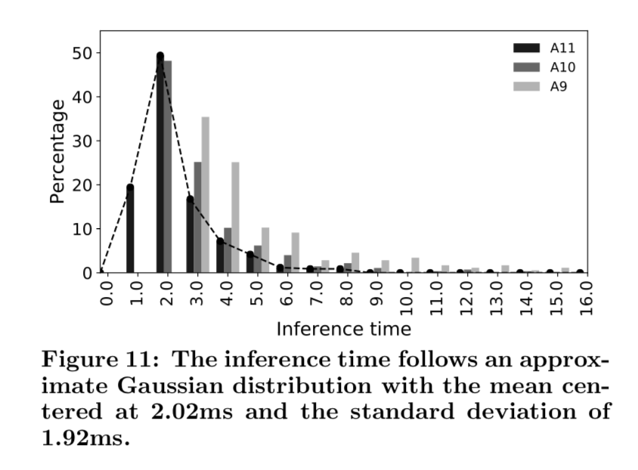
Inference in the Wild: Performance variability
Trends?
Modeled with statistical distribution

Slide 45
Summary
Hardware (CPU/GPU/DSP/NPU)
CPU
Dominant architectures
GPU
Relatively common
Performance benefit insignificant for median devices (limited by memory bandwidth)
Co-Processors (DSP/NPU)
Not prevalent
Energy Efficient
Low Programmability
The majority of mobile inference run on CPUs

Slide 46
Summary
Accuracy ⇔ Model size
Performance variability is a concern
Researchers need to consider full-picture and system effects
Trend: ML on co-processors

Slide 47
Question from Piazza
What is Facebook's final decision of hardware on mobile inference? CPU or GPU or DSP or NPU?
Is Pytorch or ONNX ever used inside of Facebook's execution flow? If we want to add Pytorch and ONNX inside of the flow, where should it be added?
Utilize both high-performance and energy efficient clusters simultaneously?

Slide 48
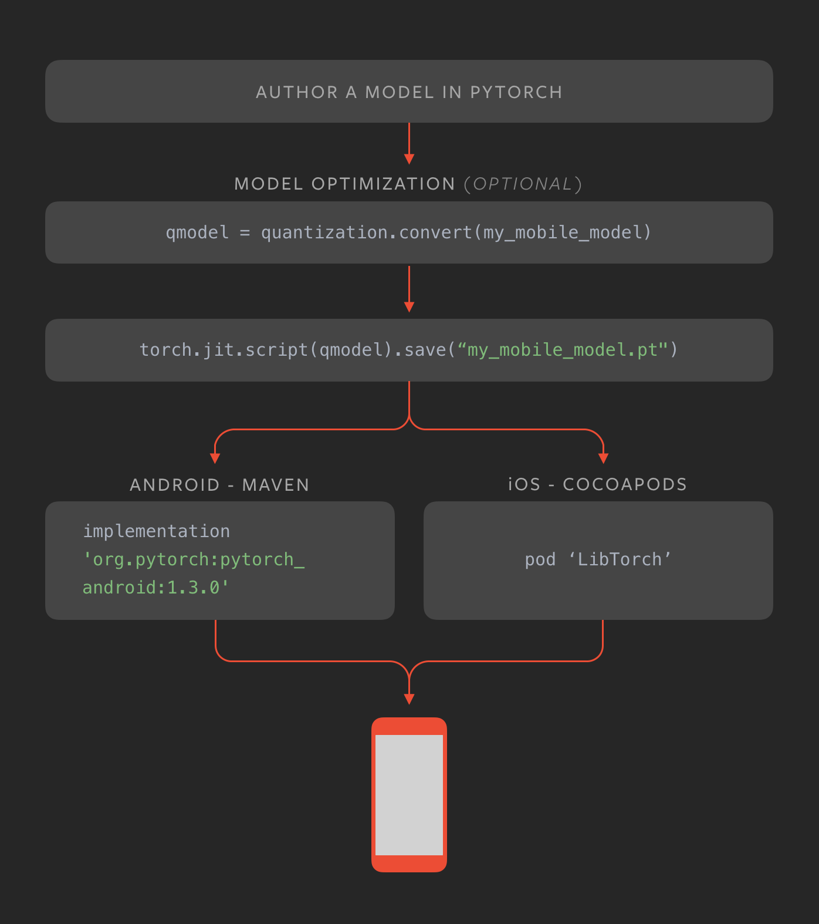
Question - PyTorch Mobile (2019.10)
New framework for Mobile ML
Support full TorchScript
All operators (on CPU)
Optimized float operators (Caffe2Go)
Optimized quantized operator (QNNPACK)
https://pytorch.org/mobile/home/

